Slide 1
Fun In The Son NYC
A Presentation for Pablo Rivera of Ek Street Group

Slide 2
Fun in the Son NYC 2015 is connecting corporations, city officials and faith communities to create a platform for diverse cultures in NYC. The collaborative efforts that creates this platform are access to affordable housing, job creation, education, training and youth programs.
The mission of Fun In The Son NYC is to provide opportunities for children and young adults to showcase their talents to a wide audience.
.
Fun In The Son NYC is embarking on its 4th year of Food, Music and Fun for the community, This international festival share a similar mission to Organizations with deep rooted commitment to the communities that support their businesses, FITS esentially taking the best of family oriented talent coupled with contextual marketing and branding to expose the world to the unique charitable work of The Good Neighbors Community Outreach Agency.
Fun In The Son NYC features numerous events and initiatives but the main event is scheduled each year on the 2nd weekend in August. The festival attracts multi-cultural crowds of over 12,000 people. The Festival features features live entertainment, Arts Craft and food vendors, Kids Zone with Bouncy Houses, lots of games, prozes and surprises. Other initiatives include “The Healthy Village”, “The Sing-OFF” and “The Back To School” drives.
Your Organization is well respected in this community and it would be our greatest honor if our organizations can partner to ensure this event remains impactful for Families in the Bronx and Metro. NY.

Slide 3
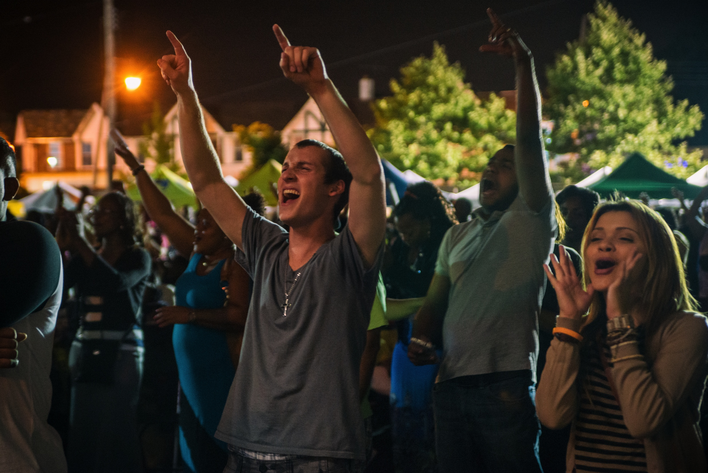
03
INTRODUCTION
Fun In The Son Festival started in 2002 on the island of Jamaica. Initially geared towards college students, the festival offered a fun filled alternative to traditional spring break activities. Today, Fun In the Son is an International festival with concerts being held in Haiti, Jamaica and The United States. Throughout the years numerous internationally acclaimed artist have graced the Fun in The Son stages including :
Hezekiah Walker, Kirk Franklyn, Tye Tribbet, Tobi Mac, Martha Munizzi, Israel Haughton, Eddie James, Papa San, Carlene Davis, Out Of Eden and Alvin Slaughter.
August 2014, Sts Philip and James School

Slide 4
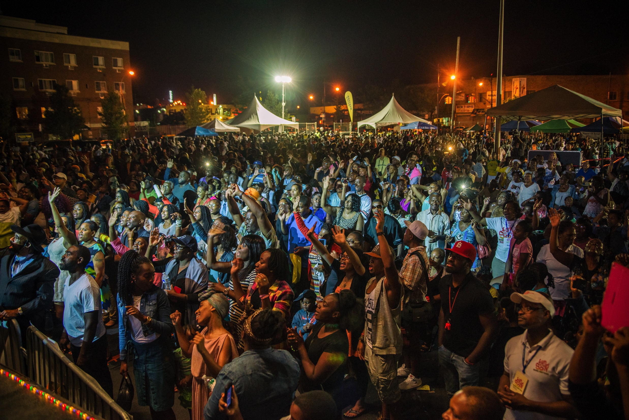
04
MEET THE TEAM
Fun In The Son NYC is produced and primarily funded by The Good Neighbors Community Outreach Agency alongside partnering churches, Corporations and Local Elected officials
Here are a few key partners:

Slide 5
05
About Us
Good Neighbors Community Outreach Agency
Good Neighbors is a multi-departmental, faith-based community development corporation serving residents and businesses throughout the tri-state area. We provide community outreach social and educational programs that address and correct today's most pressing social problems such as unemployment, economic under-development, the disintegration of the family as a social unit, inadequate public education, child care, insufficient housing conditions and immigration/citizenship issues
We are a non-profit organization located in the Northeast section of the Bronx that leverages and deploys a wide diversity of public, private and community-based resources along with comprehensive technical and practical training.
We seek to stimulate economic development in our community by providing superior instruction, counseling and programs.
What We Do
Food Network
Clothing Network
Housing Network
Single Household
Immigration Assistance
Youth Programs

Slide 6
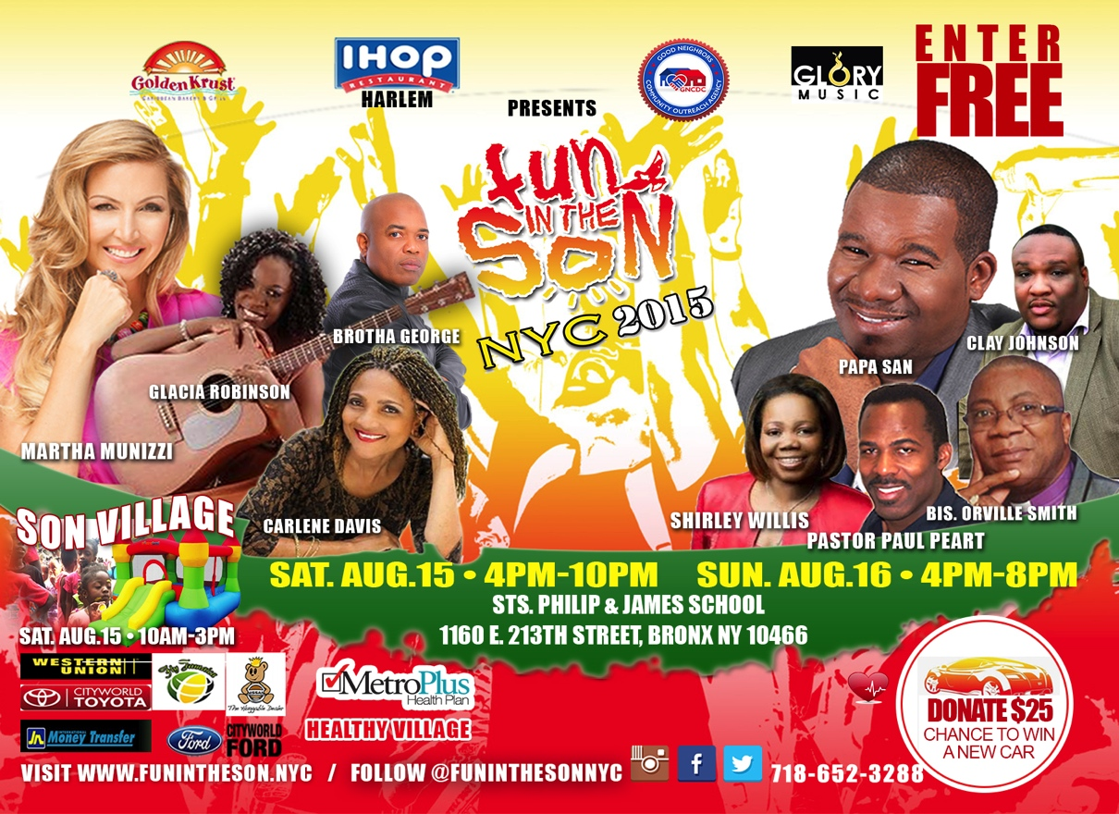
06
August 14,15,16
The Festival
Fun In The Son NYC 2016’s 3 day festival event will feature internationally renown gospel artist. Our Partners Metro Plus is sponsoring a ‘Healthy Village’ which will focus on the education of the community along with providing clinical tests such as mammograms and HIV, Aids testing
Along with the Healthy Village, Fun In The Son NYC will be hosting various activities and facilitating the giving away of educational resources for children. During the course of the weekend Fun In The Son will giveaway over 500 bag-packs filled with books, pencils, pens, art supplies and other essential learning supplies. Fun in the Son will also provide opportunities for small business to rent retail space for the weekend activities as vendors

Slide 7
7
Events Schedule
Sing-Off Contest
May 15th – August 13th
Fun In The Son NYC Youth Explosion
August 12th
Closing Session
August 14th
Fun In The Son
Media Launch
August 5th 6PM
Fun In The Son NYC 2015 Festival
August 13th
This year’s local talent development initiative, The Sing-OFF features 3 rounds of contests geared to developing artists marketability, artistry and professionalism.
Three Rounds Are :
1) Online Voting Round
2) Live Semi Final
3) Live Finale
Fun In The Son will outline the various festival schedules present Sponsors, and Partners to the Media.
Media outlets such NY 1, Bronx Net, Channel 12 Among other Terrestrial Radio Stations and Conventional Media Partners
A fun filled night, featuring premiere local Singing, Rapping and Dancing performers from New York area. This night will feature various prizes and surprises for Youth and Young Adults
The premiere Concert event in the North East Bronx, featuring, Stellar Award and Grammy Nominated artist Martha Munizzi, alongside Papa San and Friends. We expect to have over 12,000 people in attendance All day family activities include themed stalls of sponsors, health care services, children's area, food and refreshments.
An Evening of Music and Celebration.

Slide 8
8
Churches
Media
Getting Involved
Fun In The Son NYC 2016
Local Small Businesses
Helping our Community Grow
Corporate Sponsors
The Good Neighbors Community Outreach Agency has this event specifically to give North Bronx residents access to resources, information and to introduce a network of people and corporations that are inherent advocates for our community .
As the Leader in Caribbean Food products in the United States you give to the North Bronx everyday by Providing Quality food, Donating and advocating for this community. With that in mind the Organizers have some specific partnership opportunities for Grace Kennedy.
Elected Officials

Slide 9
9
Partnering Opportunity
Fun In The Son NYC is looking for Sponsorship to defray specific cost associated with the Event Production, Sponsoring any of the remaining items can be done in three different ways. The Gold Sponsor, Silver Sponsor or The Bronze Sponsor Levels
NAME
Headline Artist
Headline Artist
Headline Artist
Sound and Stage
DESCRIPTION
Martha Munizzi and Band
Papa San and Band
Carlene Davis
Rios Entertainment Services
COST
$15,000
$10,000
$10,000
$38,600
Sponsorship Needed
$12,000
$7,000
$7,000
$25,000

Slide 10
Gold Sponsor $5,000
10
In association with (name of your business) on print promotions
Incorporation of (name of your business) name/logo on traditional and new media
advertising (where possible)
Booth for promotion of sales, services & products at the main venue
Inclusion of your business logo on flyers
Inclusion of (name of your business) representative at interviews where possible
(name of your business) giveaways included in media promotions
VIP Seating at conferences and concert
Designated space for branding at the main event and other related events where allowed
Incorporation of (name of your business) name/logo on traditional and new media advertising (where possible)
Logo on Fun In The Son website (www.funintheson.nyc)
'On stage' recognition of sponsorship at events
Incorporation in social media promotions for the events, including Twitter, Facebook, Instagram &You Tube, where applicable.
Silver Sponsorship
$2,500
Half-page Ad in Fun In The Son Journal
Complimentary advertising on Facebook and Twitter page
(15) Festival T-shirts – Logo incorporated on T-shirts
Brand name listed on all printed material
One (1) (10 x 10) display space with tent in prominent area of the venue to display signage
Rights to display, sell merchandise and distribute product samples (medium display area)
Sponsor name on event program
On stage recognition at 3-day event
Bronze Sponsorship: $1,500
Quarter-page Ad in Fun In The Son Journal
Complimentary advertising on Facebook and Twitter page
Rights to display flyers and coupons by walking the festival grounds (small booth)
Brand name listed on all printed material
Sponsor name on event program

Slide 11
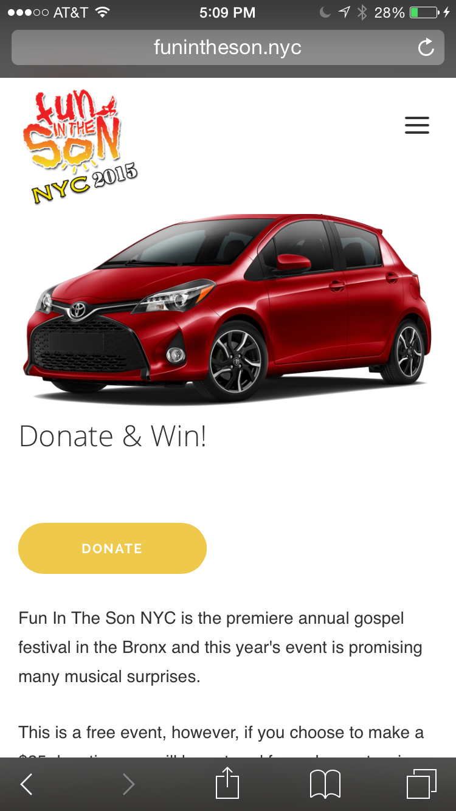
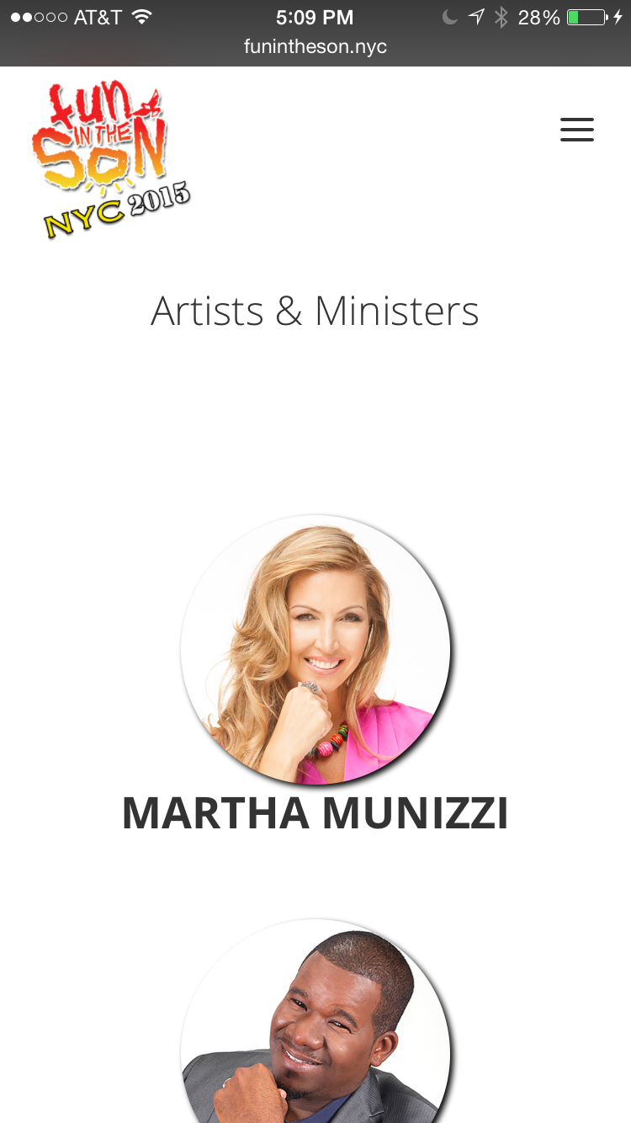
11
More than an Event but an ongoing relationship
Social Media
Fun in the son’s Social Media will promote Grace Kennedy products and initiatives ongoing until March 2016
Events
Grace will enjoy its brand promotion in our Sing-Off and Media Day events. Our online voting Sing-Off contest attracks thousands of Digital Views



Digital Magazine
Fun in the Son will have a quarterly online magazine where Grace Kennedy will be advertised

Radio Streaming
Over 20 local stations streamed Fun In The Son 2014. Every Stream will mention Grace as a sponsor in 2015
Web Site
Currently Funintheson.nyc gains over 1,200 unique users on average per month and over 6,000 pages views. The Web site will stay current with updates information including sponsors and partners.
Mobile
All our multimedia and Website content is mobile to attract a new generation of Consumers.
When You give to the Fun In The Son Festival, you become a member of the ongoing supportive community that The Good Neighbor Community Outreach Agency is establishing, this community educates, it feeds, it supports and it advocates for the Bronx long after Fun in the Son NYC 2015 is over. We would be honored if Grace Kennedy could become a contributing member.

Slide 12
Please Contact us with Your Decision at your earliest convenience. Sponsorship can be completed at our website www.funintheson.nyc
Thanks For Your Consideration
3356 Seymour Avenue, Bronx, NY 10469, P: 718-652-3288, F: 718-944-4183
Good Neighbors Community Outreach Agency is a Subsidiary of New Testament Temple Church of God

